Slide 1

PREDICTING BREAST CANCER PATIENT STATUS BASED ON PROTEIN LEVELS AND CLINICAL FEATURES USING RANDOM FOREST CLASSIFIER
BHARGAV IPPA
T00704580

Slide 2
Project Overview
Objective: Predict breast cancer patient survival status using protein levels and clinical features.
Methodology: Random Forest Classifier
Key Deliverables: Model performance metrics, feature importance analysis

Slide 3
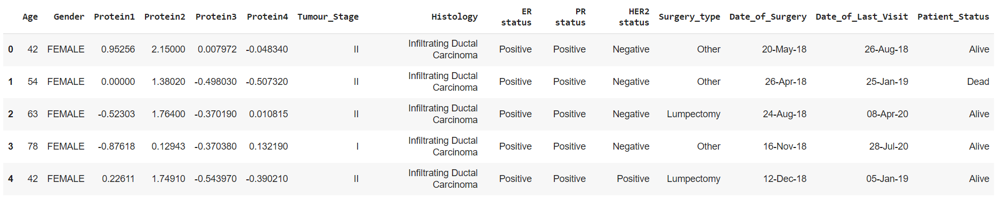
Dataset Description
Dataset: Breast cancer patient data with clinical and protein features

Slide 4
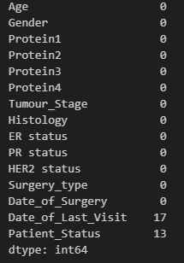

DATA PREPROCESSING
Handling Missing Data
Categorical Encoding
Data Split

Slide 5
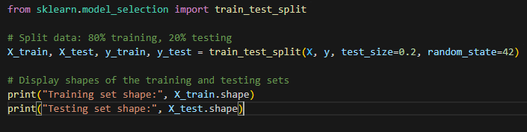
Model Selection and Training
Model Chosen: Random Forest Classifier
Reasoning:
* Robust to overfitting with many features
* Captures non-linear relationships between features

Slide 6
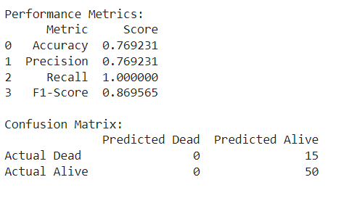
Model Performance
Metrics Overview

Slide 7
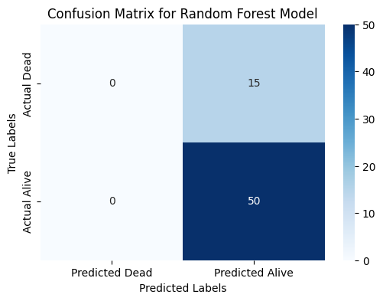
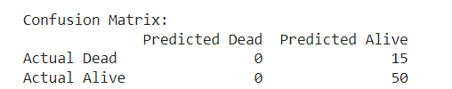
Confusion Matrix

Slide 8
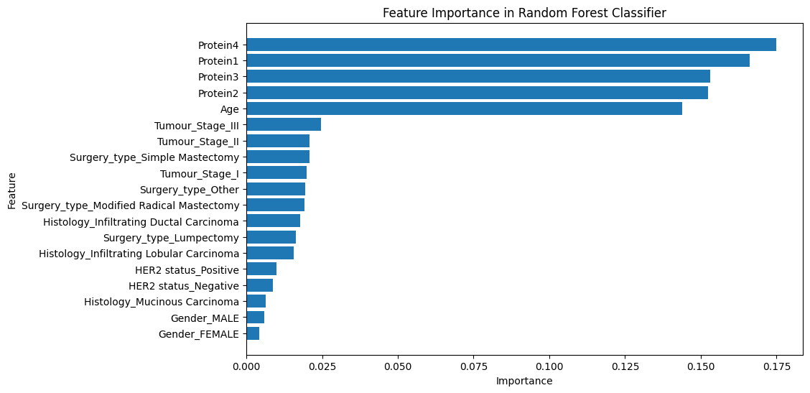
Feature Importance
Top Contributing Features

Slide 9
Conclusion and Insights
Findings:
Model achieved high recall; all "Alive" cases correctly identified
Protein levels and certain clinical features strongly influence predictions
Considerations:
Addressing the misclassification of "Dead" cases might improve model

Slide 10
Future Work
Improvement Areas:
Class Imbalance: Techniques like SMOTE (Synthetic Minority Over-sampling Technique) could improve classification of "Dead" cases.
Alternative Models: Exploring other models like Gradient Boosting or SVMs which can handle certain patterns in the data.
Additional Analysis:
Time-Series Analysis
Feature Engineering
Alternative Models: Explore other models like Gradient Boosting or SVMs, which may better handle certain patterns in the data.
Notes:
vklfjvfjvjfjvjfvjfevjefvjdvokdfpvfkvofkvfe

Slide 11

THANK YOU!
t
Thank You

